Slide 1

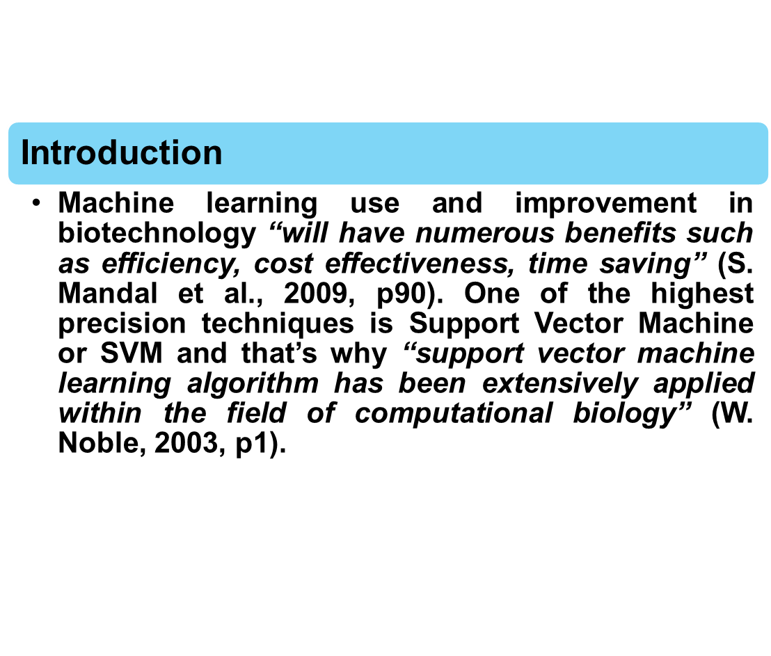
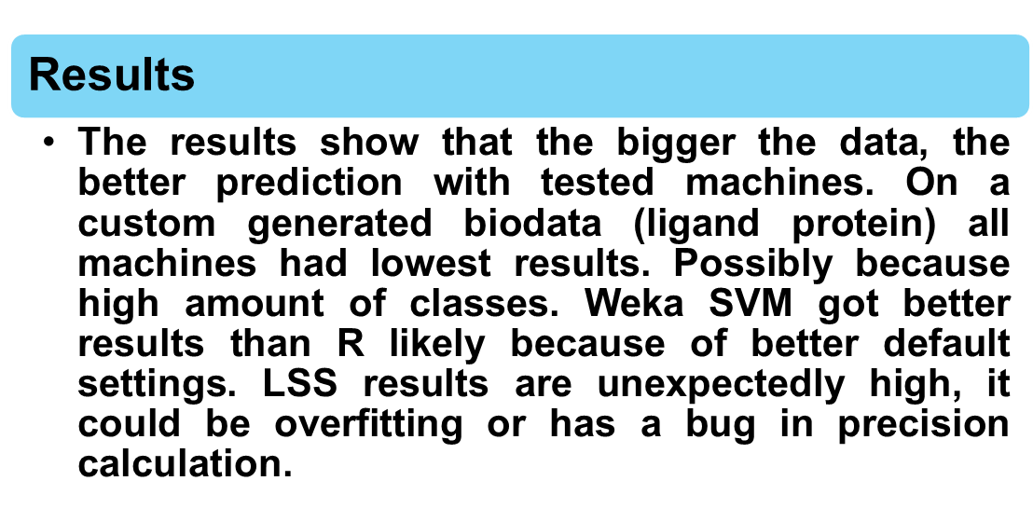
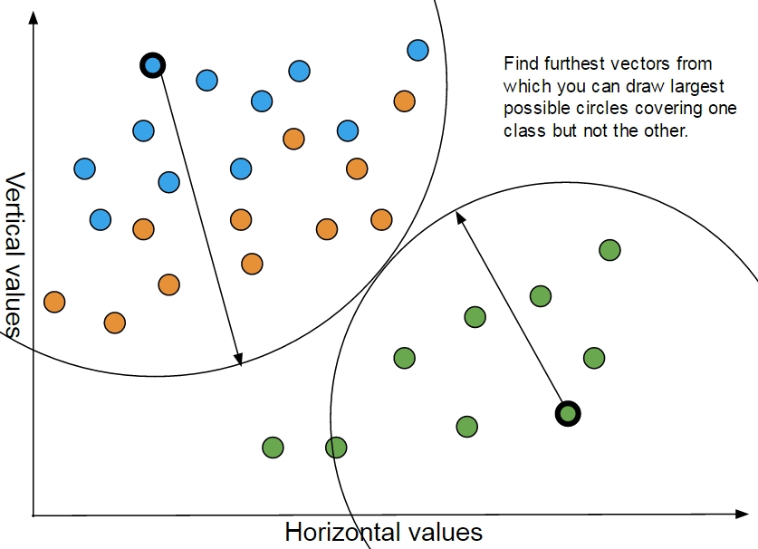
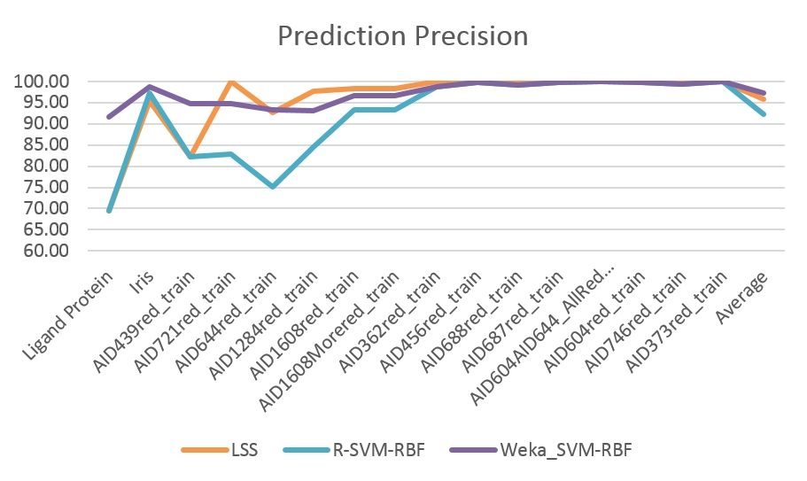
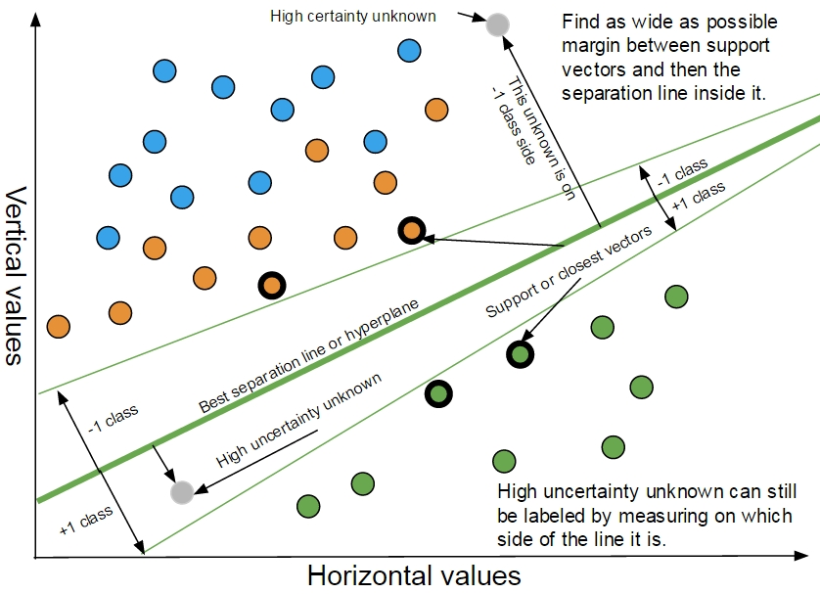
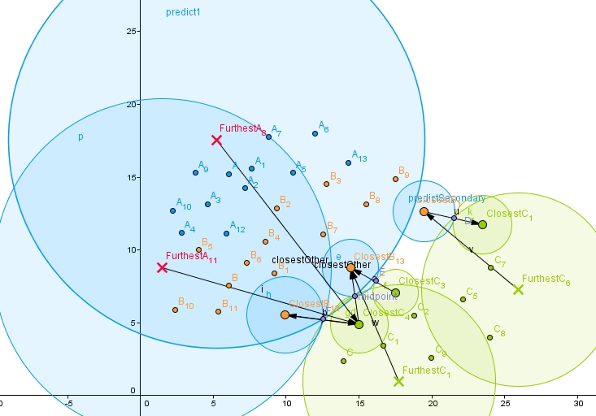
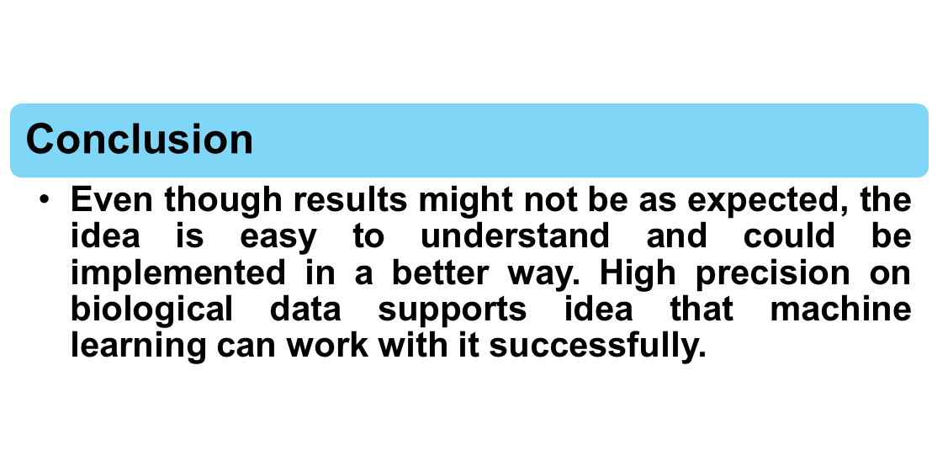
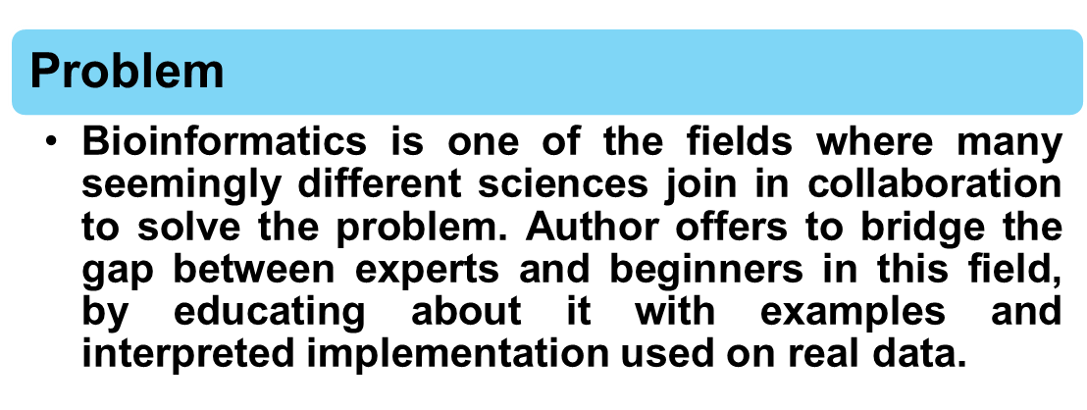
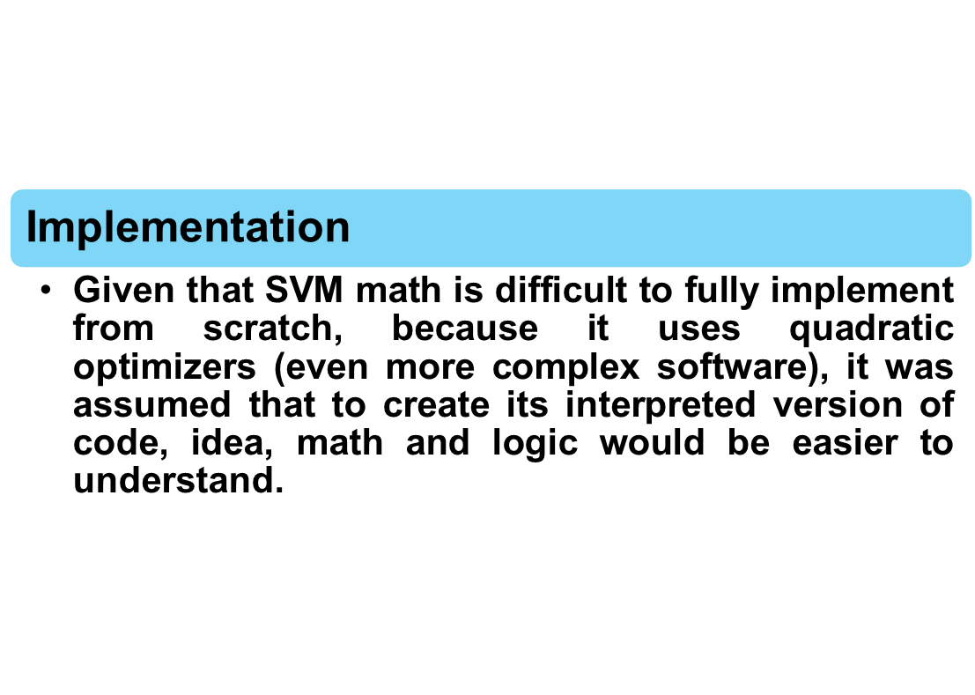
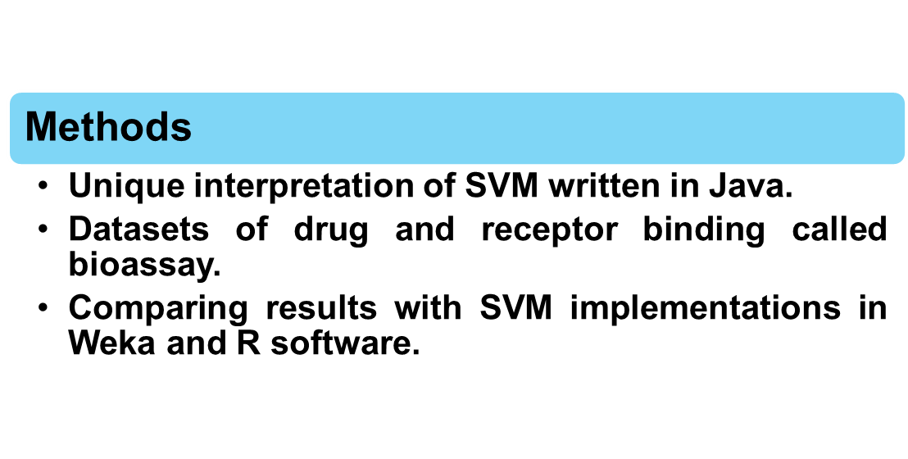
Student Number: u1334444
Supervisor Name: Ray Ruocco
Gintaras Koncevicius
Figure 2. Least Similar Sphere LSS or SVM interpretation
Figure 4. Implementation, Weka, and R precision
Figure 1. Support Vector Machine.
Acknowledgments
I would like to show my gratitude to my supervisor Mr Ray Ruocco, for having enough patience to help deal with this project implementation uncertainties and problems. I would also like to thank Dr Aaron Kans, Dr Sin Wee Lee, Dr Paolo Falcarin for teaching programming modules in a way it gave me enough confidence and skill to deal with this project.
Figure 3. How LSS uses spheres.
References
Mandal, S., Moudgil, M. and Mandal, S. (2009)., 625(1-3), pp.90-100. Rational drug design. European Journal of Pharmacology
Noble, S. (2003). Support vector machine applications in computational biology. Washington University Department of Genome Sciences, pp.1-31.

